Slide 1
Maximum Flow

Slide 2
The trucking problem of the Lucky Puck Company

Slide 3
Edmonton
Saskatoon
12
v₁
v₃
16
20
Vancouver
Winnipeg
s
4
9
7
t
factory
warehouse
13
4
v₂
v₄
14
Calgary
Regina
A flow network G = (V, E) for the Lucky Puck Company’s trucking problem. The Vancouver factory is the source s, and the Winnipeg warehouse is the sink t. The company ships pucks through intermediate cities, but only c(u, v) crates per day can go from city u to city v. Each edge is labeled with its capacity.

Slide 5
Edmonton
Saskatoon
12
v₁
v₃
16
20
Vancouver
Winnipeg
s
4
9
7
t
factory
warehouse
13
4
v₂
v₄
14
Calgary
Regina

Slide 6
12
v₁
v₃
16
20
s
4
9
7
t
13
4
v₂
v₄
14

Slide 7
0/12
v₁
v₃
0/16
0/20
s
0/4
0/9
0/7
t
0/13
0/4
v₂
v₄
0/14

Slide 8
0/12
v₁
v₃
0/16
0/20
s
0/4
0/9
0/7
t
0/13
0/4
v₂
v₄
0/14

Slide 9
4/12
v₁
v₃
4/16
0/20
s
0/4
4/9
0/7
t
0/13
4/4
v₂
v₄
4/14

Slide 10
4/12
v₁
v₃
4/16
0/20
s
0/4
4/9
0/7
t
0/13
4/4
v₂
v₄
4/14

Slide 11
12/12
v₁
v₃
12/16
8/20
s
0/4
4/9
0/7
t
0/13
4/4
v₂
v₄
4/14

Slide 12
12/12
v₁
v₃
12/16
8/20
s
0/4
4/9
0/7
t
0/13
4/4
v₂
v₄
4/14

Slide 13
12/12
v₁
v₃
12/16
15/20
s
0/4
4/9
7/7
t
7/13
4/4
v₂
v₄
11/14

Slide 14
12/12
v₁
v₃
12/16
15/20
s
0/4
4/9
7/7
t
7/13
4/4
v₂
v₄
11/14

Slide 15
12/12
v₁
v₃
12/16
19/20
s
0/4
0/9
7/7
t
11/13
4/4
v₂
v₄
11/14

Slide 16
Flow Networks
A flow network G = (V, E) is a directed simple graph in which each edge (u, v) ∈ E has a positive capacity c(u, v) > 0.
We further require that if E contains an edge (u, v), then there is no edge (v, u) in the reverse direction, and we disallow self-loops.
If (u, v) ∉ E, then we define c(u, v) = 0.
Each flow network contains two distinguished nodes: a source s and a sink t.
For convenience, we assume that each node lies on some path from the source to the sink.
Let V×V = {(x, y) | x, y ∈ V}.
If V = {a, b, c}, then
V×V = {(a, a), (a, b), (a, c), (b, a), (b, b), (b, c), (c, a), (c, b), (c, c)}.

Slide 17
12
v₁
v₃
16
20
s
8
4
21
7
t
13
4
v₂
v₄
14

Slide 18
12
v₁
v₃
16
20
8
s
v′
4
21
7
t
13
8
4
v₂
v₄
14

Slide 19
Flow Networks
A flow network G = (V, E) is a directed simple graph in which each edge (u, v) ∈ E has a positive capacity c(u, v) > 0.
We further require that if E contains an edge (u, v), then there is no edge (v, u) in the reverse direction, and we disallow self-loops.
If (u, v) ∉ E, then we define c(u, v) = 0.
Each flow network contains two distinguished nodes: a source s and a sink t.
For convenience, we assume that each node lies on some path from the source to the sink.

Slide 20
An Example of Flow Network
c(s, v₁) = 16 c(s, v₂) = 13 c(v₁, v₃) = 12 c(v₂, v₁) = 4
c(v₂, v₄) = 14 c(v₃, v₂) = 9 c(v₃, t) = 20 c(v₄, v₃) = 7
c(v₄, t) = 4
12
v₁
v₃
16
20
s
4
9
7
t
13
4
v₂
v₄
14

Slide 21
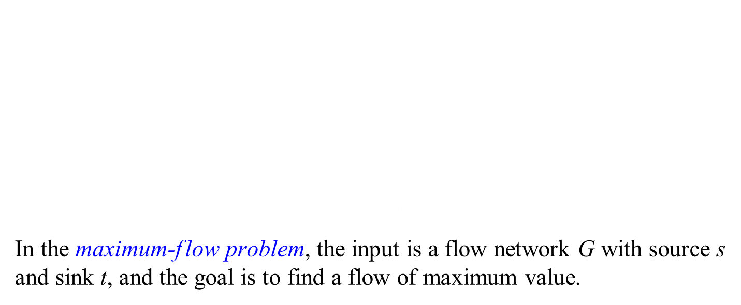
The Maximum-flow Problem
We call the nonnegative quantity f(u, v) the flow from node u to node v. The value |f| of a flow f is defined as,
$$\text{|}\text{f}\text{|}=\sum_{\text{v}\text{∈}\text{V}}{\text{f}\text{(}\text{s}\text{, }\text{v}\text{)}}−\sum_{\text{v}\text{∈}\text{V}}{\text{f}\text{(}\text{v}\text{, }\text{s}\text{)}}\text{,}$$
that is, the total flow out of the source minus the flow into the source.
In the maximum-flow problem, the input is a flow network G with source s and sink t, and the goal is to find a flow of maximum value.

Slide 22

Flow
A flow in G is a real-valued function f : V×V ⟶ R that satisfies the following two properties:
Capacity constraint: For all u, v ∈ V, 0 ≤ f (u, v) ≤ c(u, v).
$$\text{Flow} \text{conservation}\text{: }\text{For} \text{all} \text{u} \text{∈} \text{V} \text{−}\text{ \{}\text{s}\text{, }\text{t}\text{\},}\sum_{\text{v}\text{∈}\text{V}}{\text{f} \text{(}\text{v}\text{, }\text{u}\text{)}}=\sum_{\text{v}\text{∈}\text{V}}{\text{f} \text{(}\text{u}\text{, }\text{v}\text{)}}.$$
When (u, v) ∉ E, there can be no flow from u to v, and f (u, v) = 0.
Let V×V = {(x, y) | x, y ∈ V}.
If V = {a, b, c}, then
V×V = {(a, a), (a, b), (a, c), (b, a), (b, b), (b, c), (c, a), (c, b), (c, c)}.

Slide 23

Flow
A flow in G is a real-valued function f : V×V ⟶ R that satisfies the following two properties:
Capacity constraint: For all u, v ∈ V, 0 ≤ f (u, v) ≤ c(u, v).
$$\text{Flow} \text{conservation}\text{: }\text{For} \text{all} \text{u} \text{∈} \text{V} \text{−}\text{ \{}\text{s}\text{, }\text{t}\text{\},}\sum_{\text{v}\text{∈}\text{V}}{\text{f} \text{(}\text{v}\text{, }\text{u}\text{)}}=\sum_{\text{v}\text{∈}\text{V}}{\text{f} \text{(}\text{u}\text{, }\text{v}\text{)}}.$$
When (u, v) ∉ E, there can be no flow from u to v, and f (u, v) = 0.
Let V×V = {(x, y) | x, y ∈ V}.
If V = {a, b, c}, then
V×V = {(a, a), (a, b), (a, c), (b, a), (b, b), (b, c), (c, a), (c, b), (c, c)}.

Slide 24
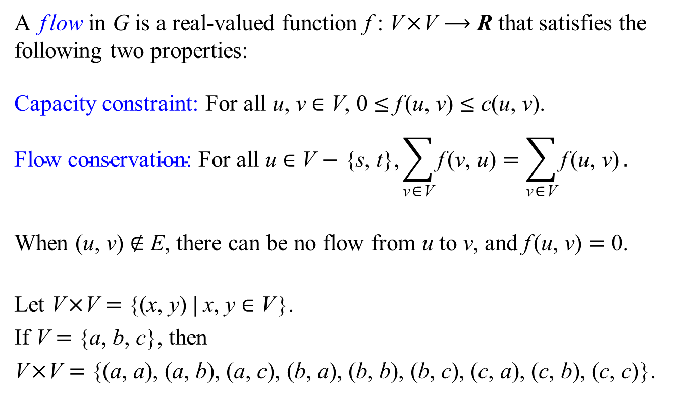
Flow
A flow in G is a real-valued function f : V×V ⟶ R that satisfies the following two properties:
Capacity constraint: For all u, v ∈ V, 0 ≤ f (u, v) ≤ c(u, v).
$$\text{Flow} \text{conservation}\text{: }\text{For} \text{all} \text{u} \text{∈} \text{V} \text{−}\text{ \{}\text{s}\text{, }\text{t}\text{\},}\sum_{\text{v}\text{∈}\text{V}}{\text{f} \text{(}\text{v}\text{, }\text{u}\text{)}}=\sum_{\text{v}\text{∈}\text{V}}{\text{f} \text{(}\text{u}\text{, }\text{v}\text{)}}.$$
When (u, v) ∉ E, there can be no flow from u to v, and f (u, v) = 0.
Let V×V = {(x, y) | x, y ∈ V}.
If V = {a, b, c}, then
V×V = {(a, a), (a, b), (a, c), (b, a), (b, b), (b, c), (c, a), (c, b), (c, c)}.

Slide 25
An Example of Flow
f (s, v₁) = 12 f (s, v₂) = 7 f (v₁, v₃) = 12 f (v₂, v₁) = 0
f (v₃, v₂) = 4 f (v₂, v₄) = 11 f (v₃, t) = 15 f (v₄, v₃) = 7
f (v₄, t) = 4
For other pairs of nodes (u, v), f (u, v) = 0 f : V ×V → R
12/12
v₁
v₃
12/16
15/20
s
0/4
4/9
7/7
t
7/13
4/4
v₂
v₄
11/14

Slide 26
The Maximum-flow Problem
We call the nonnegative quantity f(u, v) the flow from node u to node v. The value |f| of a flow f is defined as,
12/12
v₁
v₃
12/16
15/20
s
0/4
4/9
7/7
t
7/13
4/4
v₂
v₄
11/14

Slide 27
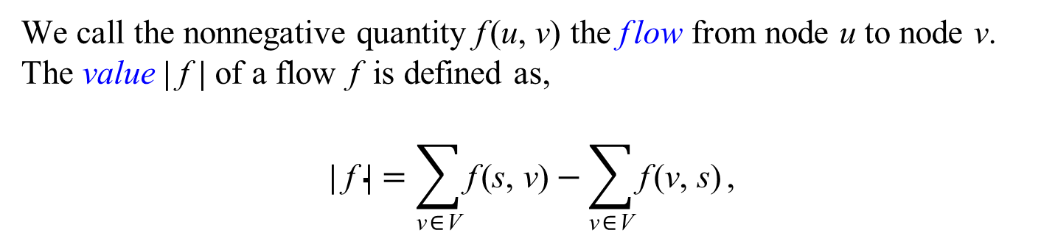
The Maximum-flow Problem
We call the nonnegative quantity f(u, v) the flow from node u to node v. The value |f| of a flow f is defined as,
$$\text{|}\text{f}\text{|}=\sum_{\text{v}\text{∈}\text{V}}{\text{f}\text{(}\text{s}\text{, }\text{v}\text{)}}−\sum_{\text{v}\text{∈}\text{V}}{\text{f}\text{(}\text{v}\text{, }\text{s}\text{)}}\text{,}$$
12/12
v₁
v₃
12/16
15/20
s
0/4
4/9
7/7
t
7/13
4/4
v₂
v₄
11/14

Slide 28
The Maximum-flow Problem
We call the nonnegative quantity f(u, v) the flow from node u to node v. The value |f| of a flow f is defined as,
$$\text{|}\text{f}\text{|}=\sum_{\text{v}\text{∈}\text{V}}{\text{f}\text{(}\text{s}\text{, }\text{v}\text{)}}−\sum_{\text{v}\text{∈}\text{V}}{\text{f}\text{(}\text{v}\text{, }\text{s}\text{)}}\text{,}$$
12/12
v₁
v₃
12/16
15/20
4/9
s
7/7
t
0/4
11/13
4/4
v₂
v₄
11/14

Slide 29
The Maximum-flow Problem
We call the nonnegative quantity f(u, v) the flow from node u to node v. The value |f| of a flow f is defined as,
$$\text{|}\text{f}\text{|}=\sum_{\text{v}\text{∈}\text{V}}{\text{f}\text{(}\text{s}\text{, }\text{v}\text{)}}−\sum_{\text{v}\text{∈}\text{V}}{\text{f}\text{(}\text{v}\text{, }\text{s}\text{)}}\text{,}$$
8/12
v₁
v₃
8/16
15/20
0/9
s
7/7
t
0/4
11/13
4/4
v₂
v₄
11/14

Slide 30
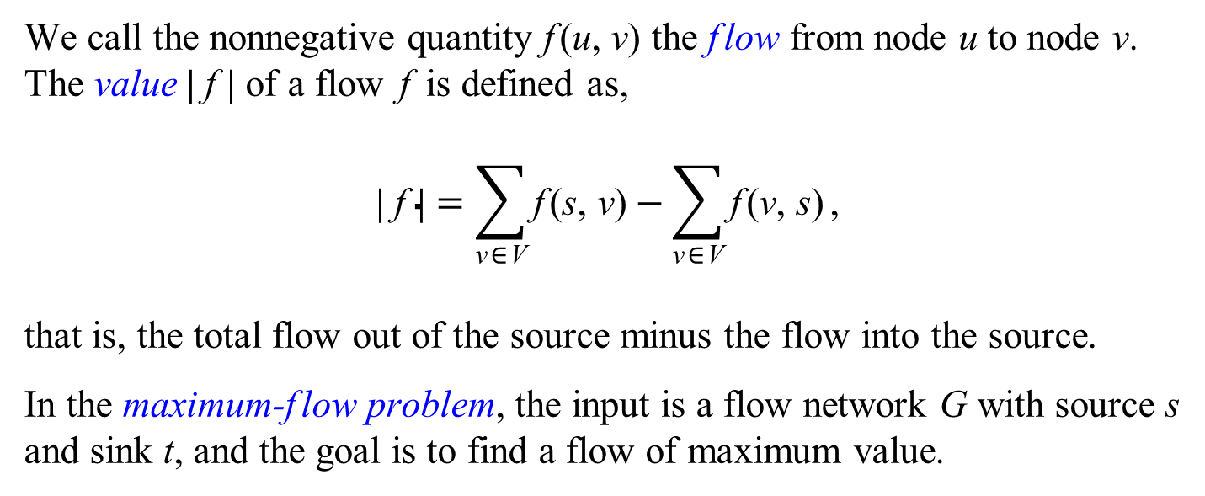
The Maximum-flow Problem
We call the nonnegative quantity f(u, v) the flow from node u to node v. The value |f| of a flow f is defined as,
$$\text{|}\text{f}\text{|}=\sum_{\text{v}\text{∈}\text{V}}{\text{f}\text{(}\text{s}\text{, }\text{v}\text{)}}−\sum_{\text{v}\text{∈}\text{V}}{\text{f}\text{(}\text{v}\text{, }\text{s}\text{)}}\text{,}$$
that is, the total flow out of the source minus the flow into the source.
In the maximum-flow problem, the input is a flow network G with source s and sink t, and the goal is to find a flow of maximum value.

Slide 31
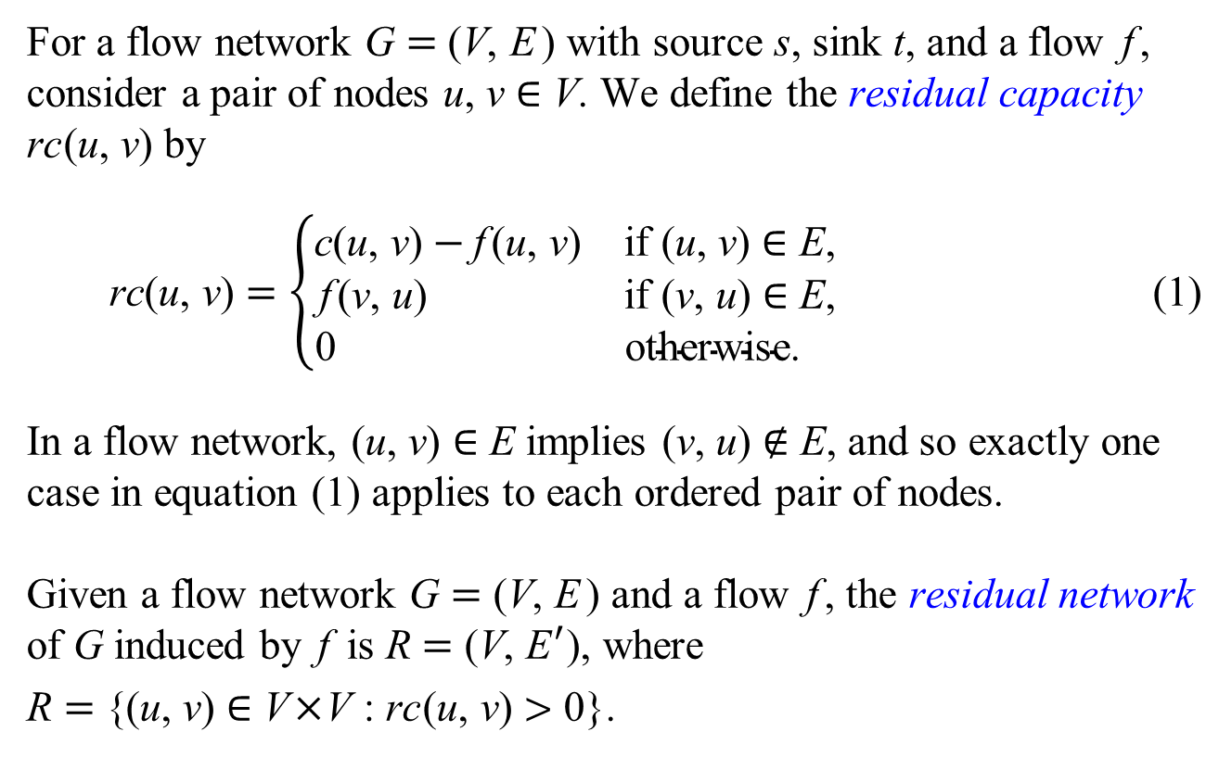
Residual Networks
For a flow network G = (V, E ) with source s, sink t, and a flow f, consider a pair of nodes u, v ∈ V. We define the residual capacity rc(u, v) by
$$\text{r}\text{c}\text{(}\text{u}\text{, }\text{v}\text{)}=\left\{\begin{matrix}\text{c}\text{(}\text{u}\text{, }\text{v}\text{)}−\text{f} \text{(}\text{u}\text{, }\text{v}\text{)} & \text{if} \text{(}\text{u}\text{, }\text{v}\text{)} \text{∈} \text{E}\text{,} \\ \text{f} \text{(}\text{v}\text{, }\text{u}\text{)} & \text{if} \text{(}\text{v}\text{, }\text{u}\text{) }\text{∈} \text{E}\text{,} \\ \text{0 } & \text{otherwise}\text{. }\end{matrix}\right. \text{(1)}$$
In a flow network, (u, v) ∈ E implies (v, u) ∉ E, and so exactly one case in equation (1) applies to each ordered pair of nodes.
Given a flow network G = (V, E ) and a flow f, the residual network of G induced by f is R = (V, E′), where
R = {(u, v) ∈ V×V : rc(u, v) > 0}.

Slide 32
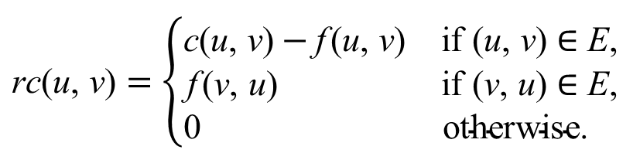
A flow network G
$$\text{rc}\text{(}\text{u}\text{, }\text{v}\text{)}=\left\{\begin{matrix}\text{c}\text{(}\text{u}\text{, }\text{v}\text{)}−\text{f} \text{(}\text{u}\text{, }\text{v}\text{)} & \text{if} \text{(}\text{u}\text{, }\text{v}\text{) }\text{∈} \text{E}\text{,} \\ \text{f} \text{(}\text{v}\text{, }\text{u}\text{) } & \text{if} \text{(}\text{v}\text{, }\text{u}\text{) }\text{∈} \text{E}\text{,} \\ \text{0 } & \text{otherwise}\text{. }\end{matrix}\right.$$
The residual network R of G
E′ = { (u, v) ∈ V×V : rc(u, v) > 0}

Slide 33
A flow network G
$$\text{rc}\text{(}\text{u}\text{, }\text{v}\text{)}=\left\{\begin{matrix}\text{c}\text{(}\text{u}\text{, }\text{v}\text{)}−\text{f} \text{(}\text{u}\text{, }\text{v}\text{)} & \text{if} \text{(}\text{u}\text{, }\text{v}\text{) }\text{∈} \text{E}\text{,} \\ \text{f} \text{(}\text{v}\text{, }\text{u}\text{) } & \text{if} \text{(}\text{v}\text{, }\text{u}\text{) }\text{∈} \text{E}\text{,} \\ \text{0 } & \text{otherwise}\text{. }\end{matrix}\right.$$
The residual network R of G
E′ = { (u, v) ∈ V×V : rc(u, v) > 0}

Slide 34
A flow network G
$$\text{rc}\text{(}\text{u}\text{, }\text{v}\text{)}=\left\{\begin{matrix}\text{c}\text{(}\text{u}\text{, }\text{v}\text{)}−\text{f} \text{(}\text{u}\text{, }\text{v}\text{)} & \text{if} \text{(}\text{u}\text{, }\text{v}\text{) }\text{∈} \text{E}\text{,} \\ \text{f} \text{(}\text{v}\text{, }\text{u}\text{) } & \text{if} \text{(}\text{v}\text{, }\text{u}\text{) }\text{∈} \text{E}\text{,} \\ \text{0 } & \text{otherwise}\text{. }\end{matrix}\right.$$
The residual network R of G
E′ = { (u, v) ∈ V×V : rc(u, v) > 0}

Slide 35
A flow network G
$$\text{rc}\text{(}\text{u}\text{, }\text{v}\text{)}=\left\{\begin{matrix}\text{c}\text{(}\text{u}\text{, }\text{v}\text{)}−\text{f} \text{(}\text{u}\text{, }\text{v}\text{)} & \text{if} \text{(}\text{u}\text{, }\text{v}\text{) }\text{∈} \text{E}\text{,} \\ \text{f} \text{(}\text{v}\text{, }\text{u}\text{) } & \text{if} \text{(}\text{v}\text{, }\text{u}\text{) }\text{∈} \text{E}\text{,} \\ \text{0 } & \text{otherwise}\text{. }\end{matrix}\right.$$
The residual network R of G
E′ = { (u, v) ∈ V×V : rc(u, v) > 0}

Slide 36
A flow network G
$$\text{rc}\text{(}\text{u}\text{, }\text{v}\text{)}=\left\{\begin{matrix}\text{c}\text{(}\text{u}\text{, }\text{v}\text{)}−\text{f} \text{(}\text{u}\text{, }\text{v}\text{)} & \text{if} \text{(}\text{u}\text{, }\text{v}\text{) }\text{∈} \text{E}\text{,} \\ \text{f} \text{(}\text{v}\text{, }\text{u}\text{) } & \text{if} \text{(}\text{v}\text{, }\text{u}\text{) }\text{∈} \text{E}\text{,} \\ \text{0 } & \text{otherwise}\text{. }\end{matrix}\right.$$
The residual network R of G
E′ = { (u, v) ∈ V×V : rc(u, v) > 0}

Slide 37
FordFulkerson(G, s, t)
1 for each edge (u, v) ∈ G.E
2 f[u][v] = 0
3 while there exists a path p from s to t in the residual network R
4 rc(p) = min{rc(u, v) : (u, v) is in p}
5 for each edge (u, v) in p
6 if (u, v) ∈ G.E
7 f[u][v] = f[u][v] + rc(p)
8 else f[v][u] = f[v][u] − rc(p)
Lestor R. Ford, Jr. and D. R. Fulkerson. Flows in Networks. Princeton University Press, 1962.

Slide 38
G
if (u, v) ∈ G.E
f[u][v] = f[u][v] + rc(p)
else f[v][u] = f[v][u] − rc(p)
R

Slide 39
G
if (u, v) ∈ G.E
f[u][v] = f[u][v] + rc(p)
else f[v][u] = f[v][u] − rc(p)
R

Slide 40
G
if (u, v) ∈ G.E
f[u][v] = f[u][v] + rc(p)
else f[v][u] = f[v][u] − rc(p)
R

Slide 41
G
if (u, v) ∈ G.E
f[u][v] = f[u][v] + rc(p)
else f[v][u] = f[v][u] − rc(p)
R

Slide 42
G
if (u, v) ∈ G.E
f[u][v] = f[u][v] + rc(p)
else f[v][u] = f[v][u] − rc(p)
R

Slide 43
G
if (u, v) ∈ G.E
f[u][v] = f[u][v] + rc(p)
else f[v][u] = f[v][u] − rc(p)
R

Slide 44
G
if (u, v) ∈ G.E
f[u][v] = f[u][v] + rc(p)
else f[v][u] = f[v][u] − rc(p)
R

Slide 45
G
if (u, v) ∈ G.E
f[u][v] = f[u][v] + rc(p)
else f[v][u] = f[v][u] − rc(p)
R

Slide 46
G
if (u, v) ∈ G.E
f[u][v] = f[u][v] + rc(p)
else f[v][u] = f[v][u] − rc(p)
R

Slide 47
G
if (u, v) ∈ G.E
f[u][v] = f[u][v] + rc(p)
else f[v][u] = f[v][u] − rc(p)
R

Slide 48
G
if (u, v) ∈ G.E
f[u][v] = f[u][v] + rc(p)
else f[v][u] = f[v][u] − rc(p)
R

Slide 49
G
if (u, v) ∈ G.E
f[u][v] = f[u][v] + rc(p)
else f[v][u] = f[v][u] − rc(p)
R

Slide 50
G
if (u, v) ∈ G.E
f[u][v] = f[u][v] + rc(p)
else f[v][u] = f[v][u] − rc(p)
R

Slide 51
Cuts of flow networks

Slide 52
12
v₁
v₃
16
20
s
4
21
7
t
13
4
v₂
v₄
14

Slide 53
Partition
(S, T) is a partition of V if and only if
S ⋂ T = ∅, and S ⋃ T = V.
Let V = {s, v₁, v₂, v₃, v₄, t}.
Then ({s, v₁, v₂}, {v₃, v₄, t}) is a partition of V.

Slide 54
A cut (S, T) of flow network G = (V, E) is a partition of V into S and T = V − S such that s ∈ S and t ∈ T.
12
v₁
v₃
16
20
s
4
9
7
t
13
4
v₂
v₄
14
({s, v₁, v₂}, {v₃, v₄, t}) is a cut of the above flow network.

Slide 55
The capacity of the cut (S, T) is
12
v₁
v₃
16
20
s
4
9
7
t
13
4
v₂
v₄
14
c(S, T) = c(v₁, v₃) + c(v₂, v₄) = 12 + 14 = 26.

Slide 56
If f is a flow, then the net flow f(S, T) across the cut (S, T)
is defined to be
12/12
v₁
v₃
12/16
15/20
S
T
s
0/4
4/9
7/7
t
7/13
4/4
v₂
v₄
11/14
f(S, T) = f(v₁, v₃) + f(v₂, v₄) − f(v₃, v₂) = 12 + 11 − 4 = 19.

Slide 57
The Maximum-flow Problem
We call the nonnegative quantity f(u, v) the flow from node u to node v. The value |f| of a flow f is defined as,
$$\text{|}\text{f}\text{|}=\sum_{\text{v}\text{∈}\text{V}}{\text{f}\text{(}\text{s}\text{, }\text{v}\text{)}}−\sum_{\text{v}\text{∈}\text{V}}{\text{f}\text{(}\text{v}\text{, }\text{s}\text{)}}\text{,}$$
that is, the total flow out of the source minus the flow into the source.
In the maximum-flow problem, the input is a flow network G with source s and sink t, and the goal is to find a flow of maximum value.

Slide 58
Lemma 1 Let f be a flow in a flow network G with source s and sink t, and let (S, T) be any cut of G. Then f(S, T) = | f |.
Lemma 2 The value of any flow f in a flow network G is bounded from above by the capacity of any cut of G.
Lemma 3 Let f be a flow in a flow network G = (V, E) with source s and sink t. Define S = {u ∈ V : there is a path from s to u in the residual network R} and T = V − S. If the residual network R contains no paths from s to t, then (S, T) is a cut of G.
Proof Since there is no path from s to t in R, we have t ∉ S. Hence t ∈ T.
By the definition of S, s ∈ S. It follows that the partition (S, T) is a cut of G.
The cut (S, T) defined in Lemma 3 is called the critical cut with respect to f.

Slide 59
Theorem 4 (Max-flow min-cut theorem)
Let f be a flow in a flow network G = (V, E) with source s and sink t. If the residual network R = (V, E′) contains no paths from s to t, and let (S, T) be the critical cut with respect to f, then f is a maximum flow in G and (S, T) is a minimum cut in G.
A minimum cut of a network is a cut whose capacity is minimum over all cuts of the network.

Slide 60
Critical Cut
G
R

Slide 61
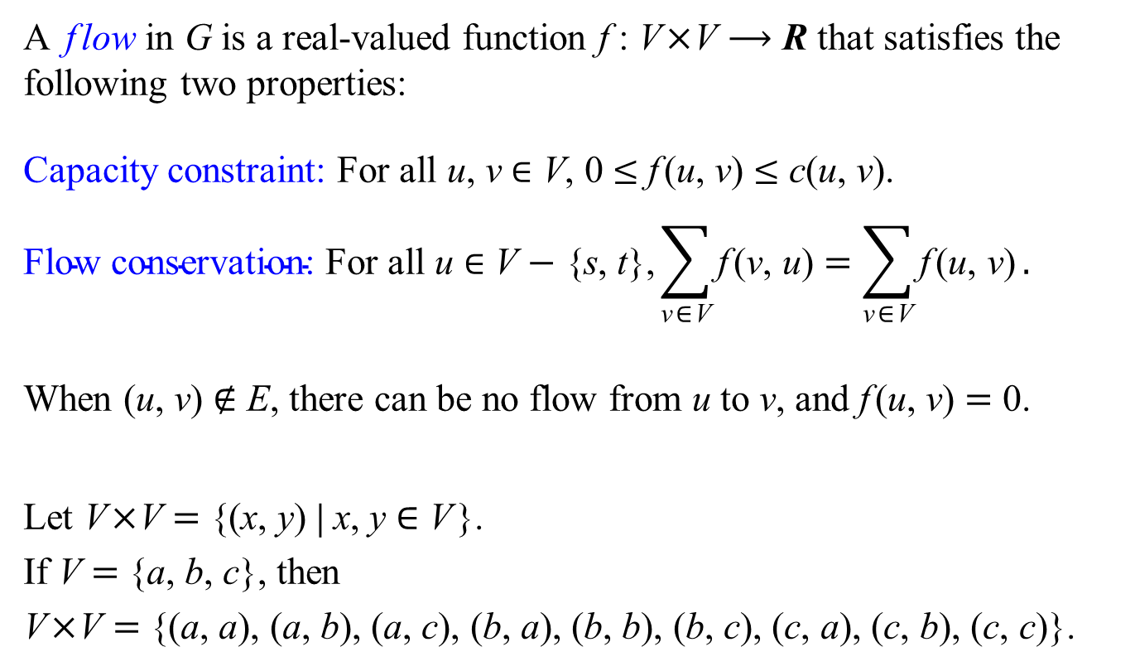
Flow
A flow in G is a real-valued function f : V×V ⟶ R that satisfies the following two properties:
Capacity constraint: For all u, v ∈ V, 0 ≤ f (u, v) ≤ c(u, v).
$$\text{Flow} \text{conservation}\text{: }\text{For} \text{all} \text{u} \text{∈} \text{V} \text{−}\text{ \{}\text{s}\text{, }\text{t}\text{\},}\sum_{\text{v}\text{∈}\text{V}}{\text{f} \text{(}\text{v}\text{, }\text{u}\text{)}}=\sum_{\text{v}\text{∈}\text{V}}{\text{f} \text{(}\text{u}\text{, }\text{v}\text{)}}.$$
When (u, v) ∉ E, there can be no flow from u to v, and f (u, v) = 0.
Let V×V = {(x, y) | x, y ∈ V}.
If V = {a, b, c}, then
V×V = {(a, a), (a, b), (a, c), (b, a), (b, b), (b, c), (c, a), (c, b), (c, c)}.

Slide 62
FordFulkerson(G, s, t)
1 for each edge (u, v) ∈ G.E
2 f[u][v] = 0
3 while there exists a path p from s to t in the residual network R
4 rc(p) = min{rc(u, v) : (u, v) is in p}
5 for each edge (u, v) in p
6 if (u, v) ∈ G.E
7 f[u][v] = f[u][v] + rc(p)
8 else f[v][u] = f[v][u] − rc(p)
Lestor R. Ford, Jr. and D. R. Fulkerson. Flows in Networks. Princeton University Press, 1962.

Slide 63
High Implementation Overhead
FordFulkerson(G, s, t)
1 for each edge (u, v) ∈ G.E
2 f[u][v] = 0
3 while there exists a path p from s to t in the residual network R
4 rc(p) = min{rc(u, v) : (u, v) is in p}
5 for each edge (u, v) in p
6 if (u, v) ∈ G.E
7 f[u][v] = f[u][v] + rc(p)
8 else f[v][u] = f[v][u] − rc(p)
The topology of the residual network R changes for each iteration of the while loop.

Slide 65
Flow Networks
A flow network G = (V, E) is a directed graph in which each edge (u, v) ∈ E has a positive capacity c(u, v) > 0.
We further require that if E contains an edge (u, v), then there is no edge (v, u) in the reverse direction, and we disallow self-loops.
If (u, v) ∉ E, then we define c(u, v) = 0.
Each flow network contains two distinguished nodes: a source s and a sink t.
For convenience, we assume that each node lies on some path from the source to the sink.
Let V×V = {(x, y) | x, y ∈ V}.
If V = {a, b, c}, then
V×V = {(a, a), (a, b), (a, c), (b, a), (b, b), (b, c), (c, a), (c, b), (c, c)}.

Slide 66
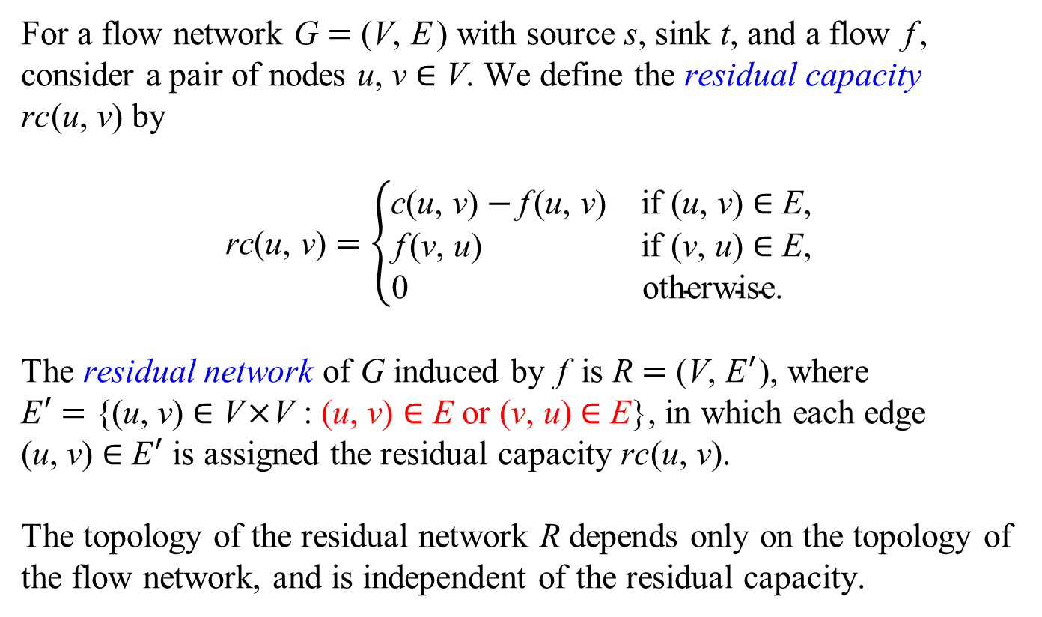
Residual Networks − Modified
For a flow network G = (V, E ) with source s, sink t, and a flow f, consider a pair of nodes u, v ∈ V. We define the residual capacity rc(u, v) by
$$\text{r}\text{c}\text{(}\text{u}\text{, }\text{v}\text{)}=\left\{\begin{matrix}\text{c}\text{(}\text{u}\text{, }\text{v}\text{)}−\text{f} \text{(}\text{u}\text{, }\text{v}\text{)} & \text{if} \text{(}\text{u}\text{, }\text{v}\text{)} \text{∈} \text{E}\text{,} \\ \text{f} \text{(}\text{v}\text{, }\text{u}\text{)} & \text{if} \text{(}\text{v}\text{, }\text{u}\text{) }\text{∈} \text{E}\text{,} \\ \text{0 } & \text{otherwise}\text{. }\end{matrix}\right.$$
The residual network of G induced by f is R = (V, E′), where
E′ = {(u, v) ∈ V×V : (u, v) ∈ E or (v, u) ∈ E}, in which each edge (u, v) ∈ E′ is assigned the residual capacity rc(u, v).
The topology of the residual network R depends only on the topology of the flow network, and is independent of the residual capacity.

Slide 67
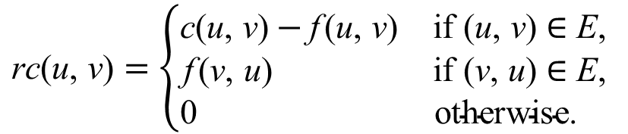
A flow network G
$$\text{rc}\text{(}\text{u}\text{, }\text{v}\text{)}=\left\{\begin{matrix}\text{c}\text{(}\text{u}\text{, }\text{v}\text{)}−\text{f} \text{(}\text{u}\text{, }\text{v}\text{)} & \text{if} \text{(}\text{u}\text{, }\text{v}\text{) }\text{∈} \text{E}\text{,} \\ \text{f} \text{(}\text{v}\text{, }\text{u}\text{) } & \text{if} \text{(}\text{v}\text{, }\text{u}\text{) }\text{∈} \text{E}\text{,} \\ \text{0 } & \text{otherwise}\text{. }\end{matrix}\right.$$
The residual network R of G
E′ = { (u, v) ∈ V×V : rc(u, v) > 0}

Slide 68
A flow network G
$$\text{rc}\text{(}\text{u}\text{, }\text{v}\text{)}=\left\{\begin{matrix}\text{c}\text{(}\text{u}\text{, }\text{v}\text{)}−\text{f} \text{(}\text{u}\text{, }\text{v}\text{)} & \text{if} \text{(}\text{u}\text{, }\text{v}\text{) }\text{∈} \text{E}\text{,} \\ \text{f} \text{(}\text{v}\text{, }\text{u}\text{) } & \text{if} \text{(}\text{v}\text{, }\text{u}\text{) }\text{∈} \text{E}\text{,} \\ \text{0 } & \text{otherwise}\text{. }\end{matrix}\right.$$
The residual network R of G
E′ = { (u, v) ∈ V×V :
(u, v) ∈ E or (v, u) ∈ E}

Slide 69
High Implementation Overhead
FordFulkerson(G, s, t)
1 for each edge (u, v) ∈ G.E
2 f[u][v] = 0
3 while there exists a path p from s to t in the residual network R
4 rc(p) = min{rc(u, v) : (u, v) is in p}
5 for each edge (u, v) in p
6 if (u, v) ∈ G.E
7 f[u][v] = f[u][v] + rc(p)
8 else f[v][u] = f[v][u] − rc(p)
The topology of the residual network R changes for each iteration of the while loop.

Slide 70
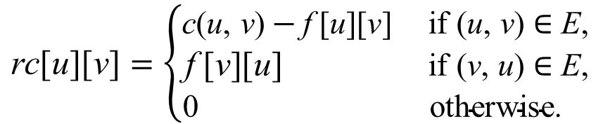
$$\text{r}\text{c}\text{[}\text{u}\text{][}\text{v}\text{]}=\left\{\begin{matrix}\text{c}\text{(}\text{u}\text{, }\text{v}\text{)}−\text{f}\text{[}\text{u}\text{][}\text{v}\text{]} & \text{if}\text{ (}\text{u}\text{, }\text{v}\text{) }\text{∈} \text{E}\text{,} \\ \text{f}\text{[}\text{v}\text{][}\text{u}\text{]} & \text{if}\text{ (}\text{v}\text{, }\text{u}\text{) }\text{∈} \text{E}\text{,} \\ \text{0} & \text{otherwise}\text{. }\end{matrix}\right.$$
FordFulkerson2(G, s, t)
1 for each node u ∈ G.V
2 for each node v ∈ G.V
3 f[u][v] = 0, rc[u][v] = c(u, v)
4 maxflow = 0
5 while there exists a path p from s to t in the residual network R
such that for each edge (u, v) in p, rc[u][v] > 0
6 rc(p) = min{rc[u][v] : (u, v) is in p}
7 maxflow = maxflow + rc(p)
8 for each edge (u, v) in p
9 if (u, v) ∈ G.E
10 f[u][v] = f[u][v] + rc(p)
11 else f[v][u] = f[v][u] − rc(p)
12 return maxflow
We assume that the nodes of G = (V, E) are numbered 1, 2, ..., n, where n = |V|, and let ( f[u][v]) and (rc[u][v]) be n×n 2-d arrays.

Slide 71
Residual Networks − Modified
For a flow network G = (V, E ) with source s, sink t, and a flow f, consider a pair of nodes u, v ∈ V. We define the residual capacity rc(u, v) by
$$\text{r}\text{c}\text{(}\text{u}\text{, }\text{v}\text{)}=\left\{\begin{matrix}\text{c}\text{(}\text{u}\text{, }\text{v}\text{)}−\text{f} \text{(}\text{u}\text{, }\text{v}\text{)} & \text{if} \text{(}\text{u}\text{, }\text{v}\text{)} \text{∈} \text{E}\text{,} \\ \text{f} \text{(}\text{v}\text{, }\text{u}\text{)} & \text{if} \text{(}\text{v}\text{, }\text{u}\text{) }\text{∈} \text{E}\text{,} \\ \text{0 } & \text{otherwise}\text{. }\end{matrix}\right.$$
The residual network of G induced by f is R = (V, E′), where
E′ = {(u, v) ∈ V×V : (u, v) ∈ E or (v, u) ∈ E}, in which each edge (u, v) ∈ E′ is assigned the residual capacity rc(u, v).
The topology of the residual network R depends only on the topology of the flow network, and is independent of the residual capacity.

Slide 72
G
if (u, v) ∈ G.E
else f[u][v] = f[u][v] + rc(p)
else f[v][u] = f[v][u] − rc(p)
rc[u][v] = rc[u][v] − rc(p)
rc[v][u] = rc[v][u] + rc(p)
R

Slide 73
G
if (u, v) ∈ G.E
else f[u][v] = f[u][v] + rc(p)
else f[v][u] = f[v][u] − rc(p)
rc[u][v] = rc[u][v] − rc(p)
rc[v][u] = rc[v][u] + rc(p)
R

Slide 74
G
if (u, v) ∈ G.E
else f[u][v] = f[u][v] + rc(p)
else f[v][u] = f[v][u] − rc(p)
rc[u][v] = rc[u][v] − rc(p)
rc[v][u] = rc[v][u] + rc(p)
R

Slide 75
G
if (u, v) ∈ G.E
else f[u][v] = f[u][v] + rc(p)
else f[v][u] = f[v][u] − rc(p)
rc[u][v] = rc[u][v] − rc(p)
rc[v][u] = rc[v][u] + rc(p)
R

Slide 76
G
if (u, v) ∈ G.E
else f[u][v] = f[u][v] + rc(p)
else f[v][u] = f[v][u] − rc(p)
rc[u][v] = rc[u][v] − rc(p)
rc[v][u] = rc[v][u] + rc(p)
R

Slide 77
G
if (u, v) ∈ G.E
else f[u][v] = f[u][v] + rc(p)
else f[v][u] = f[v][u] − rc(p)
rc[u][v] = rc[u][v] − rc(p)
rc[v][u] = rc[v][u] + rc(p)
R

Slide 78
G
if (u, v) ∈ G.E
else f[u][v] = f[u][v] + rc(p)
else f[v][u] = f[v][u] − rc(p)
rc[u][v] = rc[u][v] − rc(p)
rc[v][u] = rc[v][u] + rc(p)
R

Slide 79
G
if (u, v) ∈ G.E
else f[u][v] = f[u][v] + rc(p)
else f[v][u] = f[v][u] − rc(p)
rc[u][v] = rc[u][v] − rc(p)
rc[v][u] = rc[v][u] + rc(p)
R

Slide 80
G
if (u, v) ∈ G.E
else f[u][v] = f[u][v] + rc(p)
else f[v][u] = f[v][u] − rc(p)
rc[u][v] = rc[u][v] − rc(p)
rc[v][u] = rc[v][u] + rc(p)
R

Slide 81
We assume that the nodes of R = (V, E′) are numbered 1, 2, ..., n, where n = |V|, and let R = (rc[u][v]) be an n×n 2-d array.
FordFulkerson3(R, s, t)
1 for each node u ∈ R.V
2 for each node v ∈ R.V
3 rc[u][v] = c(u, v)
4 maxflow = 0
5 while there exists a path p from s to t in the residual network R
such that for each edge (u, v) in p, rc[u][v] > 0
6 rc(p) = min{rc[u][v] : (u, v) is in p}
7 maxflow = maxflow + rc(p)
8 for each edge (u, v) in p
9 rc[u][v] = rc[u][v] − rc(p)
10 rc[v][u] = rc[v][u] + rc(p)
11 return maxflow

Slide 82
FordFulkerson3(R, s, t)
5 while there exists a path p from s to t in the residual network R
such that for each edge (u, v) in p, rc[u][v] > 0
6 rc(p) = min{rc[u][v] : (u, v) is in p}
8 for each edge (u, v) in p
9 rc[u][v] = rc[u][v] − rc(p)
10 rc[v][u] = rc[v][u] + rc(p)

Slide 83
FordFulkerson3(R, s, t)
5 while there exists a path p from s to t in the residual network R
such that for each edge (u, v) in p, rc[u][v] > 0
6 rc(p) = min{rc[u][v] : (u, v) is in p}
8 for each edge (u, v) in p
9 rc[u][v] = rc[u][v] − rc(p)
10 rc[v][u] = rc[v][u] + rc(p)

Slide 84
FordFulkerson3(R, s, t)
5 while there exists a path p from s to t in the residual network R
such that for each edge (u, v) in p, rc[u][v] > 0
6 rc(p) = min{rc[u][v] : (u, v) is in p}
8 for each edge (u, v) in p
9 rc[u][v] = rc[u][v] − rc(p)
10 rc[v][u] = rc[v][u] + rc(p)

Slide 85
FordFulkerson3(R, s, t)
5 while there exists a path p from s to t in the residual network R
such that for each edge (u, v) in p, rc[u][v] > 0
6 rc(p) = min{rc[u][v] : (u, v) is in p}
8 for each edge (u, v) in p
9 rc[u][v] = rc[u][v] − rc(p)
10 rc[v][u] = rc[v][u] + rc(p)

Slide 86
FordFulkerson3(R, s, t)
5 while there exists a path p from s to t in the residual network R
such that for each edge (u, v) in p, rc[u][v] > 0
6 rc(p) = min{rc[u][v] : (u, v) is in p}
8 for each edge (u, v) in p
9 rc[u][v] = rc[u][v] − rc(p)
10 rc[v][u] = rc[v][u] + rc(p)

Slide 87
FordFulkerson3(R, s, t)
5 while there exists a path p from s to t in the residual network R
such that for each edge (u, v) in p, rc[u][v] > 0
6 rc(p) = min{rc[u][v] : (u, v) is in p}
8 for each edge (u, v) in p
9 rc[u][v] = rc[u][v] − rc(p)
10 rc[v][u] = rc[v][u] + rc(p)

Slide 88
FordFulkerson3(R, s, t)
5 while there exists a path p from s to t in the residual network R
such that for each edge (u, v) in p, rc[u][v] > 0
6 rc(p) = min{rc[u][v] : (u, v) is in p}
8 for each edge (u, v) in p
9 rc[u][v] = rc[u][v] − rc(p)
10 rc[v][u] = rc[v][u] + rc(p)

Slide 89
FordFulkerson3(R, s, t)
5 while there exists a path p from s to t in the residual network R
such that for each edge (u, v) in p, rc[u][v] > 0
6 rc(p) = min{rc[u][v] : (u, v) is in p}
8 for each edge (u, v) in p
9 rc[u][v] = rc[u][v] − rc(p)
10 rc[v][u] = rc[v][u] + rc(p)

Slide 90
FordFulkerson3(R, s, t)
5 while there exists a path p from s to t in the residual network R
such that for each edge (u, v) in p, rc[u][v] > 0
6 rc(p) = min{rc[u][v] : (u, v) is in p}
8 for each edge (u, v) in p
9 rc[u][v] = rc[u][v] − rc(p)
10 rc[v][u] = rc[v][u] + rc(p)

Slide 91
Analysis of FordFulkerson

Slide 92
Analysis of FordFulkerson
If f* denotes a maximum flow in the a flow network with integral capacities, then a straightforward implementation of FordFulkerson executes the while loop of lines 3–8 at most | f*| times, since the flow value increases by at least one unit in each iteration.
Let m = |E|.
The time to find a path in a residual network is O(m) if we use either depth-first search or breadth-first search.
Each iteration of the while loop thus takes O(m) time, as does the initialization in lines 1–2, making the total running time of the FordFulkerson algorithm O(m| f*|).

Slide 102
In this example, we would perform a total of 2,000,000 augmentations, increasing the flow value by only 1 unit in each.

Slide 103
Analysis of FordFulkerson
If f* denotes a maximum flow in the a flow network with integral capacities, then a straightforward implementation of FordFulkerson executes the while loop of lines 3–8 at most | f*| times, since the flow value increases by at least one unit in each iteration.
Let m = |E|.
The time to find a path in a residual network is O(m) if we use either depth-first search or breadth-first search.
Each iteration of the while loop thus takes O(m) time, as does the initialization in lines 1–2, making the total running time of the FordFulkerson algorithm O(m| f*|).

Slide 104
The Edmonds-Karp algorithm
We can implement FordFulkerson by finding the augmenting path p in line 3 with a breadth-first search. That is, we choose the augmenting path as a shortest path from s to t in the residual network, where each edge has unit distance (weight). We call the FordFulkerson method so implemented the Edmonds-Karp algorithm. We can prove that the Edmonds-Karp algorithm runs in O(nm²) time, where n = |V| and m = |E|.
Jack Edmonds and Richard M. Karp. Theoretical improvements in the algorithmic efficiency for network flow problems. Journal of the ACM, 19(2):248–264, 1972.

Slide 105
G
if (u, v) ∈ G.E
else f[u][v] = f[u][v] + rc(p)
else f[v][u] = f[v][u] − rc(p)
rc[u][v] = rc[u][v] − rc(p)
rc[v][u] = rc[v][u] + rc(p)
R

Slide 106
G
if (u, v) ∈ G.E
else f[u][v] = f[u][v] + rc(p)
else f[v][u] = f[v][u] − rc(p)
rc[u][v] = rc[u][v] − rc(p)
rc[v][u] = rc[v][u] + rc(p)
R

Slide 107
G
if (u, v) ∈ G.E
else f[u][v] = f[u][v] + rc(p)
else f[v][u] = f[v][u] − rc(p)
rc[u][v] = rc[u][v] − rc(p)
rc[v][u] = rc[v][u] + rc(p)
R

Slide 108
G
if (u, v) ∈ G.E
else f[u][v] = f[u][v] + rc(p)
else f[v][u] = f[v][u] − rc(p)
rc[u][v] = rc[u][v] − rc(p)
rc[v][u] = rc[v][u] + rc(p)
R

Slide 109
G
if (u, v) ∈ G.E
else f[u][v] = f[u][v] + rc(p)
else f[v][u] = f[v][u] − rc(p)
rc[u][v] = rc[u][v] − rc(p)
rc[v][u] = rc[v][u] + rc(p)
R

Slide 110
G
if (u, v) ∈ G.E
else f[u][v] = f[u][v] + rc(p)
else f[v][u] = f[v][u] − rc(p)
rc[u][v] = rc[u][v] − rc(p)
rc[v][u] = rc[v][u] + rc(p)
R

Slide 111
G
if (u, v) ∈ G.E
else f[u][v] = f[u][v] + rc(p)
else f[v][u] = f[v][u] − rc(p)
rc[u][v] = rc[u][v] − rc(p)
rc[v][u] = rc[v][u] + rc(p)
R

Slide 112
G
if (u, v) ∈ G.E
else f[u][v] = f[u][v] + rc(p)
else f[v][u] = f[v][u] − rc(p)
rc[u][v] = rc[u][v] − rc(p)
rc[v][u] = rc[v][u] + rc(p)
R

Slide 113
G
if (u, v) ∈ G.E
else f[u][v] = f[u][v] + rc(p)
else f[v][u] = f[v][u] − rc(p)
rc[u][v] = rc[u][v] − rc(p)
rc[v][u] = rc[v][u] + rc(p)
R

Slide 114
G
if (u, v) ∈ G.E
else f[u][v] = f[u][v] + rc(p)
else f[v][u] = f[v][u] − rc(p)
rc[u][v] = rc[u][v] − rc(p)
rc[v][u] = rc[v][u] + rc(p)
R

Slide 115
The Edmonds-Karp algorithm
Theorem 24.8
If the Edmonds-Karp algorithm is run on a flow network G = (V, E) with source s and sink t, then the total number of flow augmentations performed by the algorithm is O(nm), where n = |V| and m = |E|.
Because we can implement each iteration of FordFulkerson in O(m) time when we find the augmenting path by breadth-first search, the total running time of the Edmonds-Karp algorithm is O(nm²), where n = |V| and m = |E|.

Slide 116
We assume that the nodes of R = (V, E′) are numbered 1, 2, ..., n, where n = |V|, and let R = (rc[u][v]) be an n×n 2-d array.
FordFulkerson3(R, s, t)
1 for each node u ∈ R.V
2 for each node v ∈ R.V
3 rc[u][v] = c(u, v)
4 maxflow = 0
5 while there exists a path p from s to t in the residual network R
such that for each edge (u, v) in p, rc[u][v] > 0
6 rc(p) = min{rc[u][v] : (u, v) is in p}
7 maxflow = maxflow + rc(p)
8 for each edge (u, v) in p
9 rc[u][v] = rc[u][v] − rc(p)
10 rc[v][u] = rc[v][u] + rc(p)
11 return maxflow

Slide 117
void bfs( int s )
{
memset( parent, -1, sizeof( parent ) );
for( int i = 0; i < numNodes; i++ )
d[ i ] = inf;
d[ s ] = 0;
queue< int > q;
q.push( s );
while( !q.empty() )
{
int u = q.front();
q.pop();
for( int v : adjList[ u ] )
if( d[ v ] == inf )
{
d[ v ] = d[ u ] + 1;
parent[ v ] = u;
q.push( v );
}
}
}

Slide 118
void bfs( int s )
{
memset( parent, -1, sizeof( parent ) );
parent[ s ] = s;
queue< int > q;
q.push( s );
while( !q.empty() )
{
int u = q.front();
q.pop();
if( u == t )
return;
for( int v : adjList[ u ] )
if( resCap[ u ][ v ] > 0 && parent[ v ] == -1 )
{
parent[ v ] = u;
q.push( v );
}
}
}

Slide 119
void bfs( int s )
{
memset( parent, -1, sizeof( parent ) );
parent[ s ] = s;
queue< int > q;
q.push( s );
while( !q.empty() )
{
int u = q.front();
q.pop();
if( u == t )
return;
for( int v : adjList[ u ] )
if( resCap[ u ][ v ] > 0 && parent[ v ] == -1 )
{
parent[ v ] = u;
q.push( v );
}
}
}

Slide 120
int edmondsKarp( int s, int t )
{
int maxFlow = 0;
while( true )
{
bfs();
if( parent[ t ] == -1 )
return maxFlow;
int minResCap = inf;
for( int v = t; v != s; v = parent[ v ] )
minResCap = min( minResCap, resCap[ parent[ v ] ][ v ] );
maxFlow += minResCap;
for( int v = t; v != s; v = parent[ v ] )
{
resCap[ parent[ v ] ][ v ] -= minResCap;
resCap[ v ][ parent[ v ] ] += minResCap;
}
}
}

Slide 121
int edmondsKarp( int s, int t )
{
int maxFlow = 0;
while( true )
{
bfs();
if( parent[ t ] == -1 )
return maxFlow;
int minResCap = inf;
for( int v = t; v != s; v = parent[ v ] )
minResCap = min( minResCap, resCap[ parent[ v ] ][ v ] );
maxFlow += minResCap;
for( int v = t; v != s; v = parent[ v ] )
{
resCap[ parent[ v ] ][ v ] -= minResCap;
resCap[ v ][ parent[ v ] ] += minResCap;
}
}
}

Slide 122
int edmondsKarp( int s, int t )
{
int maxFlow = 0;
while( true )
{
bfs();
if( parent[ t ] == -1 )
return maxFlow;
int minResCap = inf;
for( int v = t; v != s; v = parent[ v ] )
minResCap = min( minResCap, resCap[ parent[ v ] ][ v ] );
maxFlow += minResCap;
for( int v = t; v != s; v = parent[ v ] )
{
resCap[ parent[ v ] ][ v ] -= minResCap;
resCap[ v ][ parent[ v ] ] += minResCap;
}
}
}

Slide 123
int edmondsKarp( int s, int t )
{
int maxFlow = 0;
while( true )
{
bfs();
if( parent[ t ] == -1 )
return maxFlow;
int minResCap = inf;
for( int v = t; v != s; v = parent[ v ] )
minResCap = min( minResCap, resCap[ parent[ v ] ][ v ] );
maxFlow += minResCap;
for( int v = t; v != s; v = parent[ v ] )
{
resCap[ parent[ v ] ][ v ] -= minResCap;
resCap[ v ][ parent[ v ] ] += minResCap;
}
}
}

Slide 124
int main()
{
int n, m;
while( cin >> n >> m )
{
int s = 0;
int t = n - 1;
memset( resCap, 0, sizeof resCap );
for( int i = s; i <= t; i++ )
adjList[ i ].clear();
int u, v, c;
for( int i = 0; i < m; ++i )
{
cin >> u >> v >> c;
resCap[ u ][ v ] = c;
adjList[ u ].push_back( v );
}
cout << edmondsKarp( s, t ) << endl;
}
}

Slide 125
while( true )
{
bfs();
if( parent[ t ] == -1 )
return maxFlow;
int minResCap = inf;
for( int v = t; v != s; v = parent[ v ] )
minResCap = min( minResCap, resCap[ parent[ v ] ][ v ] );
maxFlow += minResCap;
for( int v = t; v != s; v = parent[ v ] )
{
resCap[ parent[ v ] ][ v ] -= minResCap;
resCap[ v ][ parent[ v ] ] += minResCap;
}
}

Slide 126
while( true )
{
bfs();
if( parent[ t ] == -1 )
return maxFlow;
int minResCap = inf;
for( int v = t; v != s; v = parent[ v ] )
minResCap = min( minResCap, resCap[ parent[ v ] ][ v ] );
maxFlow += minResCap;
for( int v = t; v != s; v = parent[ v ] )
{
resCap[ parent[ v ] ][ v ] -= minResCap;
resCap[ v ][ parent[ v ] ] += minResCap;
}
}

Slide 127
while( true )
{
bfs();
if( parent[ t ] == -1 )
return maxFlow;
int minResCap = inf;
for( int v = t; v != s; v = parent[ v ] )
minResCap = min( minResCap, resCap[ parent[ v ] ][ v ] );
maxFlow += minResCap;
for( int v = t; v != s; v = parent[ v ] )
{
resCap[ parent[ v ] ][ v ] -= minResCap;
resCap[ v ][ parent[ v ] ] += minResCap;
}
}

Slide 128
while( true )
{
bfs();
if( parent[ t ] == -1 )
return maxFlow;
int minResCap = inf;
for( int v = t; v != s; v = parent[ v ] )
minResCap = min( minResCap, resCap[ parent[ v ] ][ v ] );
maxFlow += minResCap;
for( int v = t; v != s; v = parent[ v ] )
{
resCap[ parent[ v ] ][ v ] -= minResCap;
resCap[ v ][ parent[ v ] ] += minResCap;
}
}

Slide 129
while( true )
{
bfs();
if( parent[ t ] == -1 )
return maxFlow;
int minResCap = inf;
for( int v = t; v != s; v = parent[ v ] )
minResCap = min( minResCap, resCap[ parent[ v ] ][ v ] );
maxFlow += minResCap;
for( int v = t; v != s; v = parent[ v ] )
{
resCap[ parent[ v ] ][ v ] -= minResCap;
resCap[ v ][ parent[ v ] ] += minResCap;
}
}

Slide 130
while( true )
{
bfs();
if( parent[ t ] == -1 )
return maxFlow;
int minResCap = inf;
for( int v = t; v != s; v = parent[ v ] )
minResCap = min( minResCap, resCap[ parent[ v ] ][ v ] );
maxFlow += minResCap;
for( int v = t; v != s; v = parent[ v ] )
{
resCap[ parent[ v ] ][ v ] -= minResCap;
resCap[ v ][ parent[ v ] ] += minResCap;
}
}

Slide 131
while( true )
{
bfs();
if( parent[ t ] == -1 )
return maxFlow;
int minResCap = inf;
for( int v = t; v != s; v = parent[ v ] )
minResCap = min( minResCap, resCap[ parent[ v ] ][ v ] );
maxFlow += minResCap;
for( int v = t; v != s; v = parent[ v ] )
{
resCap[ parent[ v ] ][ v ] -= minResCap;
resCap[ v ][ parent[ v ] ] += minResCap;
}
}

Slide 132
while( true )
{
bfs();
if( parent[ t ] == -1 )
return maxFlow;
int minResCap = inf;
for( int v = t; v != s; v = parent[ v ] )
minResCap = min( minResCap, resCap[ parent[ v ] ][ v ] );
maxFlow += minResCap;
for( int v = t; v != s; v = parent[ v ] )
{
resCap[ parent[ v ] ][ v ] -= minResCap;
resCap[ v ][ parent[ v ] ] += minResCap;
}
}

Slide 133
while( true )
{
bfs();
if( parent[ t ] == -1 )
return maxFlow;
int minResCap = inf;
for( int v = t; v != s; v = parent[ v ] )
minResCap = min( minResCap, resCap[ parent[ v ] ][ v ] );
maxFlow += minResCap;
for( int v = t; v != s; v = parent[ v ] )
{
resCap[ parent[ v ] ][ v ] -= minResCap;
resCap[ v ][ parent[ v ] ] += minResCap;
}
}

Slide 134
while( true )
{
bfs();
if( parent[ t ] == -1 )
return maxFlow;
int minResCap = inf;
for( int v = t; v != s; v = parent[ v ] )
minResCap = min( minResCap, resCap[ parent[ v ] ][ v ] );
maxFlow += minResCap;
for( int v = t; v != s; v = parent[ v ] )
{
resCap[ parent[ v ] ][ v ] -= minResCap;
resCap[ v ][ parent[ v ] ] += minResCap;
}
}

Slide 135
while( true )
{
bfs();
if( parent[ t ] == -1 )
return maxFlow;
int minResCap = inf;
for( int v = t; v != s; v = parent[ v ] )
minResCap = min( minResCap, resCap[ parent[ v ] ][ v ] );
maxFlow += minResCap;
for( int v = t; v != s; v = parent[ v ] )
{
resCap[ parent[ v ] ][ v ] -= minResCap;
resCap[ v ][ parent[ v ] ] += minResCap;
}
}

Slide 136
while( true )
{
bfs();
if( parent[ t ] == -1 )
return maxFlow;
int minResCap = inf;
for( int v = t; v != s; v = parent[ v ] )
minResCap = min( minResCap, resCap[ parent[ v ] ][ v ] );
maxFlow += minResCap;
for( int v = t; v != s; v = parent[ v ] )
{
resCap[ parent[ v ] ][ v ] -= minResCap;
resCap[ v ][ parent[ v ] ] += minResCap;
}
}

Slide 137
void bfs( int s )
{
memset( parent, -1, sizeof( parent ) );
parent[ s ] = s;
queue< int > q;
q.push( s );
while( !q.empty() )
{
int u = q.front();
q.pop();
if( u == t )
return;
for( int v : adjList[ u ] )
if( resCap[ u ][ v ] > 0 && parent[ v ] == -1 )
{
parent[ v ] = u;
q.push( v );
}
}
}

Slide 138
int edmondsKarp( int s, int t )
{
int maxFlow = 0;
while( true )
{
bfs();
if( parent[ t ] == -1 )
return maxFlow;
int minResCap = inf;
for( int v = t; v != s; v = parent[ v ] )
minResCap = min( minResCap, resCap[ parent[ v ] ][ v ] );
maxFlow += minResCap;
for( int v = t; v != s; v = parent[ v ] )
{
resCap[ parent[ v ] ][ v ] -= minResCap;
resCap[ v ][ parent[ v ] ] += minResCap;
}
}
}

Slide 139
Dinic’s Algorithm

Slide 140
void bfs()
{
for( int i = 1; i < n; i++ )
d[ i ] = inf;
d[ s ] = 0;
queue< int > q;
q.push( s );
while( !q.empty() )
{
int u = q.front();
q.pop();
for( int v : adjList[ u ] )
if( resCap[ u ][ v ] > 0 && d[ v ] == inf )
{
d[ v ] = d[ u ] + 1;
q.push( v );
}
}
}
E. A. Dinic. Algorithm for solution of a problem of maximum flow in a network with power estimation. Soviet Mathematics Doklady, 11(5):1277–1280, 1970.

Slide 141
int dfs( int u, int partMinResCap )
{
if( u == t )
return partMinResCap;
for( int v : adjList[ u ] )
{
if( resCap[ u ][ v ] > 0 && d[ v ] == d[ u ] + 1 )
{
int minResCap = dfs( v,
min( partMinResCap, resCap[ u ][ v ] ) );
if( minResCap > 0 )
{
resCap[ u ][ v ] -= minResCap;
resCap[ v ][ u ] += minResCap;
return minResCap;
}
}
}
return 0;
}

Slide 142
int dinic()
{
int maxFlow = 0;
while( true )
{
bfs();
if( d[ t ] == inf )
return maxFlow;
while( true )
{
int minResCap = dfs( s, inf );
if( minResCap == 0 )
break;
maxFlow += minResCap;
}
}
}

Slide 143
int dfs( int u, int pmrc )
{
if( u == t )
return pmrc;
for( int v : adjList[u] )
if( rc[u][v] > 0 && d[v] == d[u] + 1 )
{
int mrc = dfs( v, min( pmrc, rc[u][v] ) );
if( mrc > 0 )
{
rc[u][v] -= mrc;
rc[v][u] += mrc;
return mrc;
}
}
return 0;
}

Slide 144
int dinic()
{
int maxFlow = 0;
while( true )
{
bfs();
if( d[t] == inf )
return maxFlow;
while( true )
{
int mrc = dfs( s, inf );
if( mrc == 0 )
break;
maxFlow += mrc;
}
}
}

Slide 145
int dfs( int u, int pmrc )
{
if( u == t )
return pmrc;
for( int v : adjList[u] )
if( rc[u][v]>0&&d[v]==d[u]+1 )
{
int mrc=dfs(v,min(pmrc,rc[u][v]));
if( mrc > 0 )
{
rc[u][v] -= mrc;
rc[v][u] += mrc;
return mrc;
}
}
return 0;
}
int dinic()
{
int maxFlow = 0;
while( true )
{
bfs();
if( d[t] == inf )
return maxFlow;
while( true )
{
int mrc=dfs(s,inf);
if( mrc == 0 )
break;
maxFlow += mrc;
}
}
}

Slide 146
int dfs( int u, int pmrc )
{
if( u == t )
return pmrc;
for( int v : adjList[u] )
if( rc[u][v]>0&&d[v]==d[u]+1 )
{
int mrc=dfs(v,min(pmrc,rc[u][v]));
if( mrc > 0 )
{
rc[u][v] -= mrc;
rc[v][u] += mrc;
return mrc;
}
}
return 0;
}
int dinic()
{
int maxFlow = 0;
while( true )
{
bfs();
if( d[t] == inf )
return maxFlow;
while( true )
{
int mrc=dfs(s,inf);
if( mrc == 0 )
break;
maxFlow += mrc;
}
}
}

Slide 147
int dfs( int u, int pmrc )
{
if( u == t )
return pmrc;
for( int v : adjList[u] )
if( rc[u][v]>0&&d[v]==d[u]+1 )
{
int mrc=dfs(v,min(pmrc,rc[u][v]));
if( mrc > 0 )
{
rc[u][v] -= mrc;
rc[v][u] += mrc;
return mrc;
}
}
return 0;
}
int dinic()
{
int maxFlow = 0;
while( true )
{
bfs();
if( d[t] == inf )
return maxFlow;
while( true )
{
int mrc=dfs(s,inf);
if( mrc == 0 )
break;
maxFlow += mrc;
}
}
}
Layered Network

Slide 148
int dfs( int u, int pmrc )
{
if( u == t )
return pmrc;
for( int v : adjList[u] )
if( rc[u][v]>0&&d[v]==d[u]+1 )
{
int mrc=dfs(v,min(pmrc,rc[u][v]));
if( mrc > 0 )
{
rc[u][v] -= mrc;
rc[v][u] += mrc;
return mrc;
}
}
return 0;
}
int dinic()
{
int maxFlow = 0;
while( true )
{
bfs();
if( d[t] == inf )
return maxFlow;
while( true )
{
int mrc=dfs(s,inf);
if( mrc == 0 )
break;
maxFlow += mrc;
}
}
}
dfs( s, ∞)
dfs( v₁, 16)
dfs( v₃, 12)
dfs( t, 12)

Slide 149
int dfs( int u, int pmrc )
{
if( u == t )
return pmrc;
for( int v : adjList[u] )
if( rc[u][v]>0&&d[v]==d[u]+1 )
{
int mrc=dfs(v,min(pmrc,rc[u][v]));
if( mrc > 0 )
{
rc[u][v] -= mrc;
rc[v][u] += mrc;
return mrc;
}
}
return 0;
}
int dinic()
{
int maxFlow = 0;
while( true )
{
bfs();
if( d[t] == inf )
return maxFlow;
while( true )
{
int mrc=dfs(s,inf);
if( mrc == 0 )
break;
maxFlow += mrc;
}
}
}
dfs( s, ∞)
dfs( v₁, 16)
dfs( v₃, 12)
12
dfs( t, 12)

Slide 150
int dfs( int u, int pmrc )
{
if( u == t )
return pmrc;
for( int v : adjList[u] )
if( rc[u][v]>0&&d[v]==d[u]+1 )
{
int mrc=dfs(v,min(pmrc,rc[u][v]));
if( mrc > 0 )
{
rc[u][v] -= mrc;
rc[v][u] += mrc;
return mrc;
}
}
return 0;
}
int dinic()
{
int maxFlow = 0;
while( true )
{
bfs();
if( d[t] == inf )
return maxFlow;
while( true )
{
int mrc=dfs(s,inf);
if( mrc == 0 )
break;
maxFlow += mrc;
}
}
}
dfs( s, ∞)
dfs( v₁, 16)
12
dfs( v₃, 12)
12
dfs( t, 12)

Slide 151
int dfs( int u, int pmrc )
{
if( u == t )
return pmrc;
for( int v : adjList[u] )
if( rc[u][v]>0&&d[v]==d[u]+1 )
{
int mrc=dfs(v,min(pmrc,rc[u][v]));
if( mrc > 0 )
{
rc[u][v] -= mrc;
rc[v][u] += mrc;
return mrc;
}
}
return 0;
}
int dinic()
{
int maxFlow = 0;
while( true )
{
bfs();
if( d[t] == inf )
return maxFlow;
while( true )
{
int mrc=dfs(s,inf);
if( mrc == 0 )
break;
maxFlow += mrc;
}
}
}
dfs( s, ∞)
12
dfs( v₁, 16)
12
dfs( v₃, 12)
12
dfs( t, 12)

Slide 152
int dfs( int u, int pmrc )
{
if( u == t )
return pmrc;
for( int v : adjList[u] )
if( rc[u][v]>0&&d[v]==d[u]+1 )
{
int mrc=dfs(v,min(pmrc,rc[u][v]));
if( mrc > 0 )
{
rc[u][v] -= mrc;
rc[v][u] += mrc;
return mrc;
}
}
return 0;
}
int dinic()
{
int maxFlow = 0;
while( true )
{
bfs();
if( d[t] == inf )
return maxFlow;
while( true )
{
int mrc=dfs(s,inf);
if( mrc == 0 )
break;
maxFlow += mrc;
}
}
}
dfs( s, ∞)
dfs( v₂, 13)
dfs( v₄, 13)
dfs( t, 4)

Slide 153
int dfs( int u, int pmrc )
{
if( u == t )
return pmrc;
for( int v : adjList[u] )
if( rc[u][v]>0&&d[v]==d[u]+1 )
{
int mrc=dfs(v,min(pmrc,rc[u][v]));
if( mrc > 0 )
{
rc[u][v] -= mrc;
rc[v][u] += mrc;
return mrc;
}
}
return 0;
}
int dinic()
{
int maxFlow = 0;
while( true )
{
bfs();
if( d[t] == inf )
return maxFlow;
while( true )
{
int mrc=dfs(s,inf);
if( mrc == 0 )
break;
maxFlow += mrc;
}
}
}
dfs( s, ∞)
dfs( v₂, 13)
dfs( v₄, 13)
4
dfs( t, 4)

Slide 154
int dfs( int u, int pmrc )
{
if( u == t )
return pmrc;
for( int v : adjList[u] )
if( rc[u][v]>0&&d[v]==d[u]+1 )
{
int mrc=dfs(v,min(pmrc,rc[u][v]));
if( mrc > 0 )
{
rc[u][v] -= mrc;
rc[v][u] += mrc;
return mrc;
}
}
return 0;
}
int dinic()
{
int maxFlow = 0;
while( true )
{
bfs();
if( d[t] == inf )
return maxFlow;
while( true )
{
int mrc=dfs(s,inf);
if( mrc == 0 )
break;
maxFlow += mrc;
}
}
}
dfs( s, ∞)
dfs( v₂, 13)
4
dfs( v₄, 13)
4
dfs( t, 4)

Slide 155
int dfs( int u, int pmrc )
{
if( u == t )
return pmrc;
for( int v : adjList[u] )
if( rc[u][v]>0&&d[v]==d[u]+1 )
{
int mrc=dfs(v,min(pmrc,rc[u][v]));
if( mrc > 0 )
{
rc[u][v] -= mrc;
rc[v][u] += mrc;
return mrc;
}
}
return 0;
}
int dinic()
{
int maxFlow = 0;
while( true )
{
bfs();
if( d[t] == inf )
return maxFlow;
while( true )
{
int mrc=dfs(s,inf);
if( mrc == 0 )
break;
maxFlow += mrc;
}
}
}
dfs( s, ∞)
4
dfs( v₂, 13)
4
dfs( v₄, 13)
4
dfs( t, 4)

Slide 156
int dfs( int u, int pmrc )
{
if( u == t )
return pmrc;
for( int v : adjList[u] )
if( rc[u][v]>0&&d[v]==d[u]+1 )
{
int mrc=dfs(v,min(pmrc,rc[u][v]));
if( mrc > 0 )
{
rc[u][v] -= mrc;
rc[v][u] += mrc;
return mrc;
}
}
return 0;
}
int dinic()
{
int maxFlow = 0;
while( true )
{
bfs();
if( d[t] == inf )
return maxFlow;
while( true )
{
int mrc=dfs(s,inf);
if( mrc == 0 )
break;
maxFlow += mrc;
}
}
}
dfs( s, ∞)
0
dfs( v₁, 4)

Slide 157
int dfs( int u, int pmrc )
{
if( u == t )
return pmrc;
for( int v : adjList[u] )
if( rc[u][v]>0&&d[v]==d[u]+1 )
{
int mrc=dfs(v,min(pmrc,rc[u][v]));
if( mrc > 0 )
{
rc[u][v] -= mrc;
rc[v][u] += mrc;
return mrc;
}
}
return 0;
}
int dinic()
{
int maxFlow = 0;
while( true )
{
bfs();
if( d[t] == inf )
return maxFlow;
while( true )
{
int mrc=dfs(s,inf);
if( mrc == 0 )
break;
maxFlow += mrc;
}
}
}
dfs( s, ∞)
0
dfs( v₂, 9)
0
dfs( v₄, 9)

Slide 158
int dfs( int u, int pmrc )
{
if( u == t )
return pmrc;
for( int v : adjList[u] )
if( rc[u][v]>0&&d[v]==d[u]+1 )
{
int mrc=dfs(v,min(pmrc,rc[u][v]));
if( mrc > 0 )
{
rc[u][v] -= mrc;
rc[v][u] += mrc;
return mrc;
}
}
return 0;
}
int dinic()
{
int maxFlow = 0;
while( true )
{
bfs();
if( d[t] == inf )
return maxFlow;
while( true )
{
int mrc=dfs(s,inf);
if( mrc == 0 )
break;
maxFlow += mrc;
}
}
}

Slide 159
int dfs( int u, int pmrc )
{
if( u == t )
return pmrc;
for( int v : adjList[u] )
if( rc[u][v]>0&&d[v]==d[u]+1 )
{
int mrc=dfs(v,min(pmrc,rc[u][v]));
if( mrc > 0 )
{
rc[u][v] -= mrc;
rc[v][u] += mrc;
return mrc;
}
}
return 0;
}
int dinic()
{
int maxFlow = 0;
while( true )
{
bfs();
if( d[t] == inf )
return maxFlow;
while( true )
{
int mrc=dfs(s,inf);
if( mrc == 0 )
break;
maxFlow += mrc;
}
}
}
Layered Network

Slide 160
int dfs( int u, int pmrc )
{
if( u == t )
return pmrc;
for( int v : adjList[u] )
if( rc[u][v]>0&&d[v]==d[u]+1 )
{
int mrc=dfs(v,min(pmrc,rc[u][v]));
if( mrc > 0 )
{
rc[u][v] -= mrc;
rc[v][u] += mrc;
return mrc;
}
}
return 0;
}
int dinic()
{
int maxFlow = 0;
while( true )
{
bfs();
if( d[t] == inf )
return maxFlow;
while( true )
{
int mrc=dfs(s,inf);
if( mrc == 0 )
break;
maxFlow += mrc;
}
}
}
dfs( s, ∞)
dfs( v₂, 9)
dfs( v₄, 9)
dfs( v₃, 7)
dfs( t, 7)

Slide 161
int dfs( int u, int pmrc )
{
if( u == t )
return pmrc;
for( int v : adjList[u] )
if( rc[u][v]>0&&d[v]==d[u]+1 )
{
int mrc=dfs(v,min(pmrc,rc[u][v]));
if( mrc > 0 )
{
rc[u][v] -= mrc;
rc[v][u] += mrc;
return mrc;
}
}
return 0;
}
int dinic()
{
int maxFlow = 0;
while( true )
{
bfs();
if( d[t] == inf )
return maxFlow;
while( true )
{
int mrc=dfs(s,inf);
if( mrc == 0 )
break;
maxFlow += mrc;
}
}
}
dfs( s, ∞)
dfs( v₂, 9)
dfs( v₄, 9)
dfs( v₃, 7)
7
dfs( t, 7)

Slide 162
int dfs( int u, int pmrc )
{
if( u == t )
return pmrc;
for( int v : adjList[u] )
if( rc[u][v]>0&&d[v]==d[u]+1 )
{
int mrc=dfs(v,min(pmrc,rc[u][v]));
if( mrc > 0 )
{
rc[u][v] -= mrc;
rc[v][u] += mrc;
return mrc;
}
}
return 0;
}
int dinic()
{
int maxFlow = 0;
while( true )
{
bfs();
if( d[t] == inf )
return maxFlow;
while( true )
{
int mrc=dfs(s,inf);
if( mrc == 0 )
break;
maxFlow += mrc;
}
}
}
dfs( s, ∞)
dfs( v₂, 9)
dfs( v₄, 9)
7
dfs( v₃, 7)
7
dfs( t, 7)

Slide 163
int dfs( int u, int pmrc )
{
if( u == t )
return pmrc;
for( int v : adjList[u] )
if( rc[u][v]>0&&d[v]==d[u]+1 )
{
int mrc=dfs(v,min(pmrc,rc[u][v]));
if( mrc > 0 )
{
rc[u][v] -= mrc;
rc[v][u] += mrc;
return mrc;
}
}
return 0;
}
int dinic()
{
int maxFlow = 0;
while( true )
{
bfs();
if( d[t] == inf )
return maxFlow;
while( true )
{
int mrc=dfs(s,inf);
if( mrc == 0 )
break;
maxFlow += mrc;
}
}
}
dfs( s, ∞)
dfs( v₂, 9)
7
dfs( v₄, 9)
7
dfs( v₃, 7)
7
dfs( t, 7)

Slide 164
int dfs( int u, int pmrc )
{
if( u == t )
return pmrc;
for( int v : adjList[u] )
if( rc[u][v]>0&&d[v]==d[u]+1 )
{
int mrc=dfs(v,min(pmrc,rc[u][v]));
if( mrc > 0 )
{
rc[u][v] -= mrc;
rc[v][u] += mrc;
return mrc;
}
}
return 0;
}
int dinic()
{
int maxFlow = 0;
while( true )
{
bfs();
if( d[t] == inf )
return maxFlow;
while( true )
{
int mrc=dfs(s,inf);
if( mrc == 0 )
break;
maxFlow += mrc;
}
}
}
dfs( s, ∞)
7
dfs( v₂, 9)
7
dfs( v₄, 9)
7
dfs( v₃, 7)
7
dfs( t, 7)

Slide 165
int dfs( int u, int pmrc )
{
if( u == t )
return pmrc;
for( int v : adjList[u] )
if( rc[u][v]>0&&d[v]==d[u]+1 )
{
int mrc=dfs(v,min(pmrc,rc[u][v]));
if( mrc > 0 )
{
rc[u][v] -= mrc;
rc[v][u] += mrc;
return mrc;
}
}
return 0;
}
int dinic()
{
int maxFlow = 0;
while( true )
{
bfs();
if( d[t] == inf )
return maxFlow;
while( true )
{
int mrc=dfs(s,inf);
if( mrc == 0 )
break;
maxFlow += mrc;
}
}
}

Slide 166
int dfs( int u, int pmrc )
{
if( u == t )
return pmrc;
for( int v : adjList[u] )
if( rc[u][v]>0&&d[v]==d[u]+1 )
{
int mrc=dfs(v,min(pmrc,rc[u][v]));
if( mrc > 0 )
{
rc[u][v] -= mrc;
rc[v][u] += mrc;
return mrc;
}
}
return 0;
}
int dinic()
{
int maxFlow = 0;
while( true )
{
bfs();
if( d[t] == inf )
return maxFlow;
while( true )
{
int mrc=dfs(s,inf);
if( mrc == 0 )
break;
maxFlow += mrc;
}
}
}
Layered Network

Slide 167
dfs(s, ∞)
dfs(v₁, 16)
dfs(v₂, 13)
dfs(v₃, 12)
dfs(v₄, 13)
dfs(t, 12)
dfs(t, 4)

Slide 168
The time complexity of Dinic's algorithm
Theorem
The worst-case time complexity of Dinic's algorithm is O(mn²), where n = |V| and m = |E|.

Slide 170
The Minimum Cut Problem
A minimum cut of a network is a cut whose capacity is minimum over all cuts of the network.
In the minimum cut problem, we are given a flow network G with source s and sink t, and we wish to find a minimum cut in G.
The capacity of the cut (S, T) is

Slide 171
Theorem 4 (Max-flow min-cut theorem)
Let f be a flow in a flow network G = (V, E) with source s and sink t. If the residual network R = (V, E′) contains no paths from s to t, and let (S, T) be the critical cut with respect to f, then f is a maximum flow in G and (S, T) is a minimum cut in G.

Slide 172
Hence f(S, T) = c(S, T).
By Lemma 1, f(S, T) = | f |, it follows that | f | = c(S, T).
Let g be any flow in G.
By Lemma 2, |g| ≤ c(S, T), and thus |g| ≤ | f |.
Therefore f is a maximum flow in G.
Let (S′, T′) be any cut of G.
By Lemma 2, | f | ≤ c(S′, T′), and thus c(S, T) ≤ c(S′, T′).
Therefore (S, T) is a minimum cut in G.
Lemma 1 Let f be a flow in a flow network G with source s and sink t, and let (S, T) be any cut of G. Then, f(S, T) = | f |.
Lemma 2 Let f be a flow in a flow network G with source s and sink t, and let (S, T) be any cut of G. Then, | f | ≤ c(S, T).

Slide 173

$$\text{f}\text{(}\text{S}\text{, }\text{T}\text{)}=\sum_{\text{u}\text{∈}\text{S}}{\sum_{\text{v}\text{∈}\text{T}}{\text{f}\text{(}\text{u}\text{, }\text{v}\text{)}}}−\sum_{\text{v}\text{∈}\text{T}}{\sum_{\text{u}\text{∈}\text{S}}{\text{f}\text{(}\text{v}\text{, }\text{u}\text{)}}}$$
$$=\sum_{\text{u}\text{∈}\text{S}}{\sum_{\text{v}\text{∈}\text{T}}{\text{c}\text{(}\text{u}\text{, }\text{v}\text{)}}}−\sum_{\text{v}\text{∈}\text{T}}{\sum_{\text{u}\text{∈}\text{S}}{\text{0}}}=\text{c}\text{(}\text{S}\text{, }\text{T}\text{)}.$$

Slide 174
G
R

Slide 175
Minimum Cut Algorithm
After maximum flow algorithm stops, we run graph traversal (DFS/BFS) from source s again.
S be the set of all reachable nodes from source s using positive residual capacity edges in the residual graph.
T be the set of all unreachable nodes.
(S, T) is a minimum cut in G.

Slide 177
Networks with Multiple Sources and Sinks
Sometimes, we can have more than one source and/or more than one sink.
Create a super source ss and a super sink st.
Connect ss with all s with infinite capacity and also connect all t with st with infinite capacity, then run Edmonds Karp’s as per normal.
The Lucky Puck Company, for example, might actually have a set of m factories {s₁, s₂, . . . , s_{m}} and a set of n warehouses {t₁, t₂, . . . , t_{n}}, as shown in Figure (a).
Figure (b) shows how to convert the network from Figure (a) to an ordinary flow network with only a single source and a single sink.

Slide 178
Networks with Multiple Sources and Sinks
We add a supersource s and add a directed edge (s, s_{i}) with capacity c(s, s_{i}) = ∞ for each i = 1, 2, . . . , m.
We also create a new supersink t and add a directed edge (t_{i}, t) with capacity c(t_{i}, t) = ∞ for each i = 1, 2, . . . , n.
Intuitively, any flow in the network in Figure (a) corresponds to a flow in the network in Figure (b), and vice versa.
The single source s simply provides as much flow as desired for the multiple sources s_{i}, and the single sink t likewise consumes as much flow as desired for the multiple sinks t_{i} .

Slide 179
Networks with Multiple Sources and Sinks
s₁
10
12
3
s₂
t₁
5
15
8
6
(a)
s₃
t₂
14
20
7
13
s₄
t₃
11
18
2
s₅

Slide 180
Networks with Multiple Sources and Sinks
(b)
s₁
10
12
3
∞
s₂
t₁
5
15
∞
∞
8
6
∞
∞
s
s₃
t₂
t
14
20
∞
∞
7
13
s₄
t₃
∞
11
18
2
s₅

Slide 182
Maximum Bipartite Matching
Given an undirected graph G = (V, E), a matching is a subset of edges M ⊆ E such that for all nodes v ∈ V, at most one edge of M is incident on v. We say that a node v ∈ V is matched by the matching M if some edge in M is incident on v; otherwise, v is unmatched. A maximum matching is a matching of maximum cardinality, that is, a matching M such that for any matching M′, we have |M| ≥ |M′|.
Bipartite graphs are graphs in which the node set can be partitioned into V = L ⋃ R, where L and R are disjoint and all edges in E go between L and R. We assume that every vertex in V has at least one incident edge.
In the maximum matching problem, we are given a bipartite graph, and we wish to find a maximum matching.

Slide 183
L
R
L
R
(a)
(b)

Slide 184
Finding a Maximum Bipartite Matching
We define the corresponding flow network G′ = (V′, E′) for the bipartite graph G as follows. We let the source s and sink t be new nodes not in V, and we let V′ = V ⋃ {s, t}. If the node partition of G is V = L ⋃ R, the directed edges of G′ are the edges of E, directed from L to R, along with |V| new directed edges:
E′ = {(s, u) : u ∈ L} ⋃ {(u, v) : {u, v} ∈ E} ⋃ {(v, t) : v ∈ R}.
To complete the construction, we assign unit capacity to each edge in E′. Since each node in V has at least one incident edge, |E| ≥ |V| / 2. Thus, |E| ≤ |E′| = |E| + |V| ≤ 3|E|, and so |E′| = Θ(E).
The following lemma shows that a matching in G corresponds directly to a flow in G′s corresponding flow network G′. We say that a flow f on a flow network G = (V, E) is integer-valued if f(u, v) is an integer for all (u, v) ∈ V ⨉V.

Slide 185
1
1
1
s
t
L
R
(c)

Slide 186
1
1
1
s
t
L
R
(c)

Slide 187
Finding a Maximum Bipartite Matching
Lemma 5
Let G = (V, E) be a bipartite graph with node partition V = L ⋃ R, and let G′ = (V′, E′) be its corresponding flow network. If M is a matching in G, then there is an integer-valued flow f in G′ with value |f| = |M|. Conversely, if f is an integer-valued flow in G′, then there is a matching M in G with cardinality |M| = |f|.
Based on Lemma 5, we would like to conclude that a maximum matching in a bipartite graph G corresponds to a maximum flow in its corresponding flow network G′, and we can therefore compute a maximum matching in G by running a maximum-flow algorithm on G′. The only hitch in this reasoning is that the maximum-flow algorithm might return a flow in G′ for which some f(u, v) is not an integer, even though the flow value |f| must be an integer. The following theorem shows that if we use the FordFulkerson method, this difficulty cannot arise.

Slide 188
Finding a Maximum Bipartite Matching
Theorem 6 (Integrality theorem)
If the capacity function c takes on only integral values, then the maximum flow f produced by the FordFulkerson method has the property that |f| is an integer. Moreover, for all nodes u and v, the value of f(u, v) is an integer.
Corollary 7
The cardinality of a maximum matching M in a bipartite graph G equals the value of a maximum flow f in its corresponding flow network G′.
UVa 259 670 753 10080 10092 10243 10418 10984 663 11148

Slide 189
Finding a Maximum Bipartite Matching
Thus, given a bipartite undirected graph G, we can find a maximum matching by creating the flow network G′, running the FordFulkerson method, and directly obtaining a maximum matching M from the integer-valued maximum flow f found. Since any matching in a bipartite graph has cardinality at most min(L, R) = O(n), the value of the maximum flow in G′ is O(n). We can therefore find a maximum matching in a bipartite graph in time O(nm′) = O(nm), since m′ = Θ(m), where n = |V|, m = |E| and m′ = |E′|.

